Slide 1
Model Inference
Aarts, Fides, Julien Schmaltz, and Frits Vaandrager. "Inference and abstraction of the biometric passport." Leveraging Applications of Formal Methods, Verification, and Validation (2010): 673-686.
Vaandrager, Frits. "Model learning." Communications of the ACM 60.2 (2017): 86-95.

Slide 2
Outline
Model of a Model
L-STAR
Biometric Passport
Abstraction
Results + Validation
Conclusion

Slide 3
Introduction

Slide 4
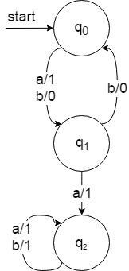




Model of a Model
Mealy machine

Slide 5
L-STAR

Slide 6
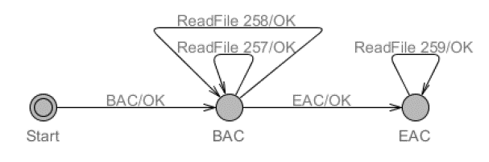

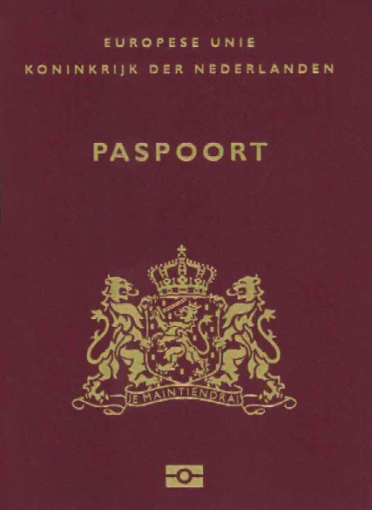
Biometric Passport
What’s in it?
BAC
Machine Readable Zone data #257
i.e.: name, date of birth, nationality
Facial Image #258
Biometric data #259
i.e.: fingerprints, iris scan
EAC

Slide 7
Abstraction Mapping
ValidAfterBAC -> 257, 258
ValidAfterEAC -> 259
NotValid -> others

Slide 8
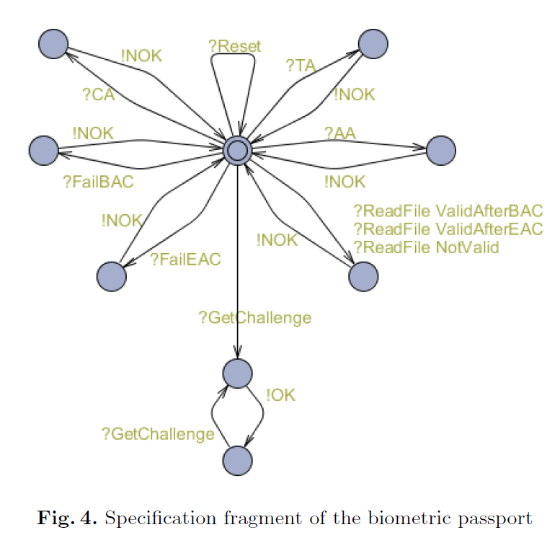
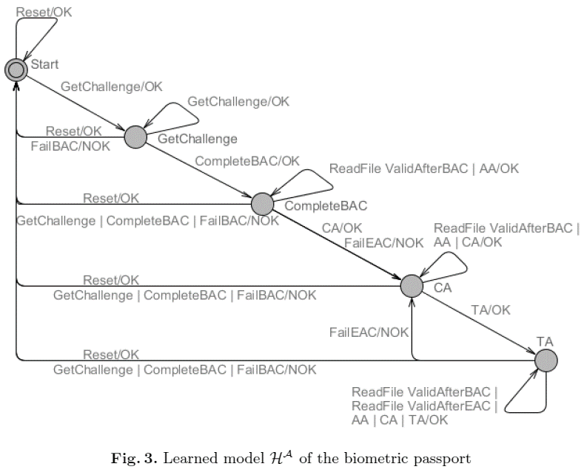
Results and Validation

Slide 9


Results and Validation
observation
equivalent
Hª
$$≅$$
Mª
transducer
observation
equivalent
H
$$≅$$
M
Notes:
From Ha to H:
Replace ValidAfterBAC in Ha by two transitions same source and target but with labels ReadFile(257) and readFile(258).
Replace ValidAfterEAC by an identical transition with label ReadFile(259)
Replace NotValid by transitions ReadFile(256). ReadFile(260)….
If M treats equivalent input symbols in an equivalent way, observation equivalence Ma and Ha, implies observation equivalence of M and H
-> Structural assumptions anout the behavior of the biometric passport, the abstraction does not lead to a loss of information.
Theorem 1
Call two input enabled actions i1, i2 of Mealy machine M equivalent, notation i1 =i2, if they are mapped to the same abstract action. Suppose that in M equivalent inputs induce identical outputs and equivalent successor states:
Then Ma ~~Ha implies M~~H.

Slide 10
Conclusion

